Slide 1
Interview Exercise
Leonard Maaya

Slide 2
Questions

Slide 3
1. Cartridge detection rates (‘positive call rates’) vs input level.
Input Level (copies/ml) | N | Detected (%)
125 | 24 | 18(0.75)
250 | 24 | 22(0.92)
500 | 24 | 24(1.00)
750 | 24 | 24(1.00)
1,000 | 24 | 24(1.00)
2,000 | 24 | 24(1.00)
4,000 | 24 | 24(1.00)

Slide 4
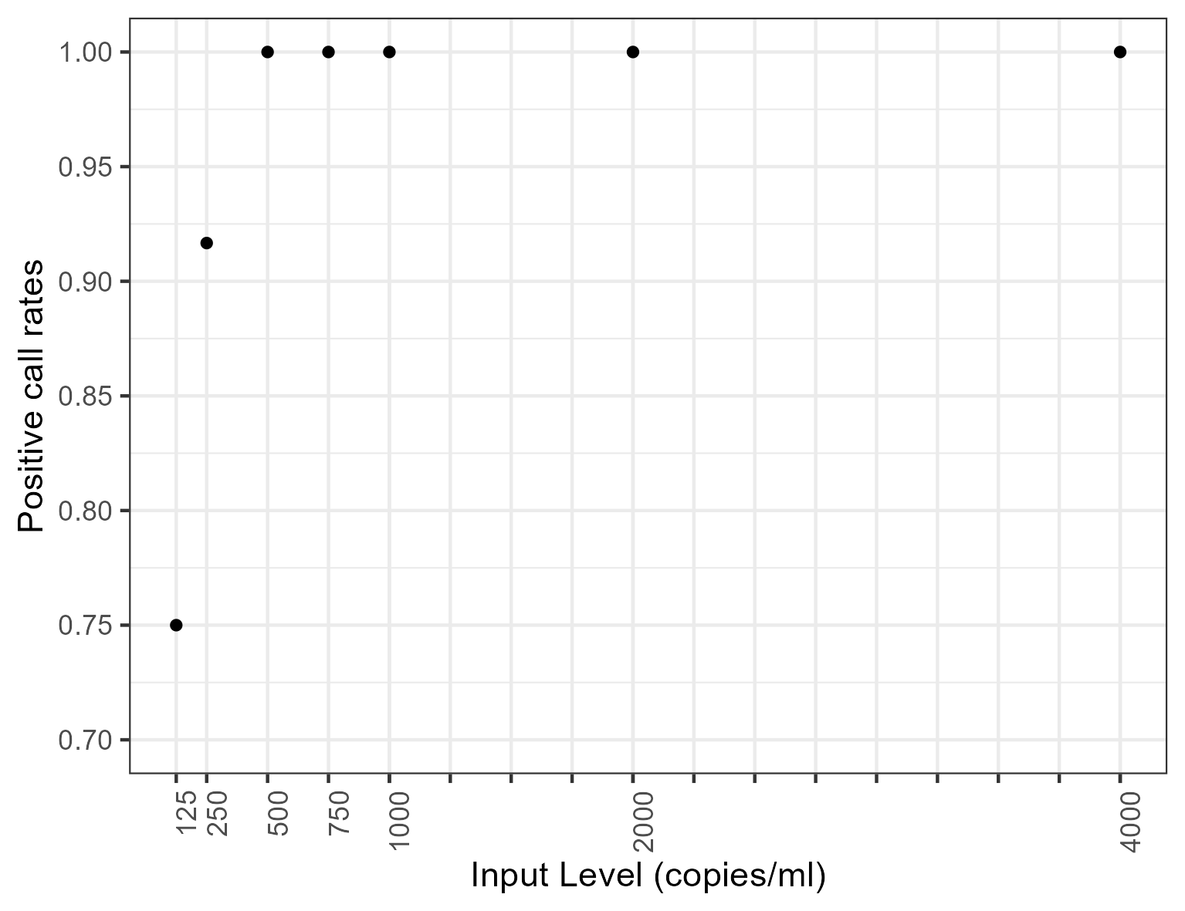
2. Positive call rates vs input levels.

Slide 5
3. Statistical model
$\text{logit(}p\text{)}=β_{0}+β_{1}\text{*input level}$
Parameter | Est. | Std. Error | z value | Pr(>|z|)
$$β_{0}$$ | -0.46 | 1.01 | -0.45 | 0.65
$$β_{1}$$ | 0.01 | 0.01 | 2.11 | 0.03

Slide 6
Lowest input level (cps/ml) with 95% positive call rates:
282
Corresponding 95% Wilson CI for the input level (cps/ml):
c(146, 418)

Slide 7
To be checked
Operator vs Positive call rates
Day vs Positive call rates
Day-Operator vs Positive call rates

Slide 8
Modeling
Include the other variables?
Bayesian?

Slide 9
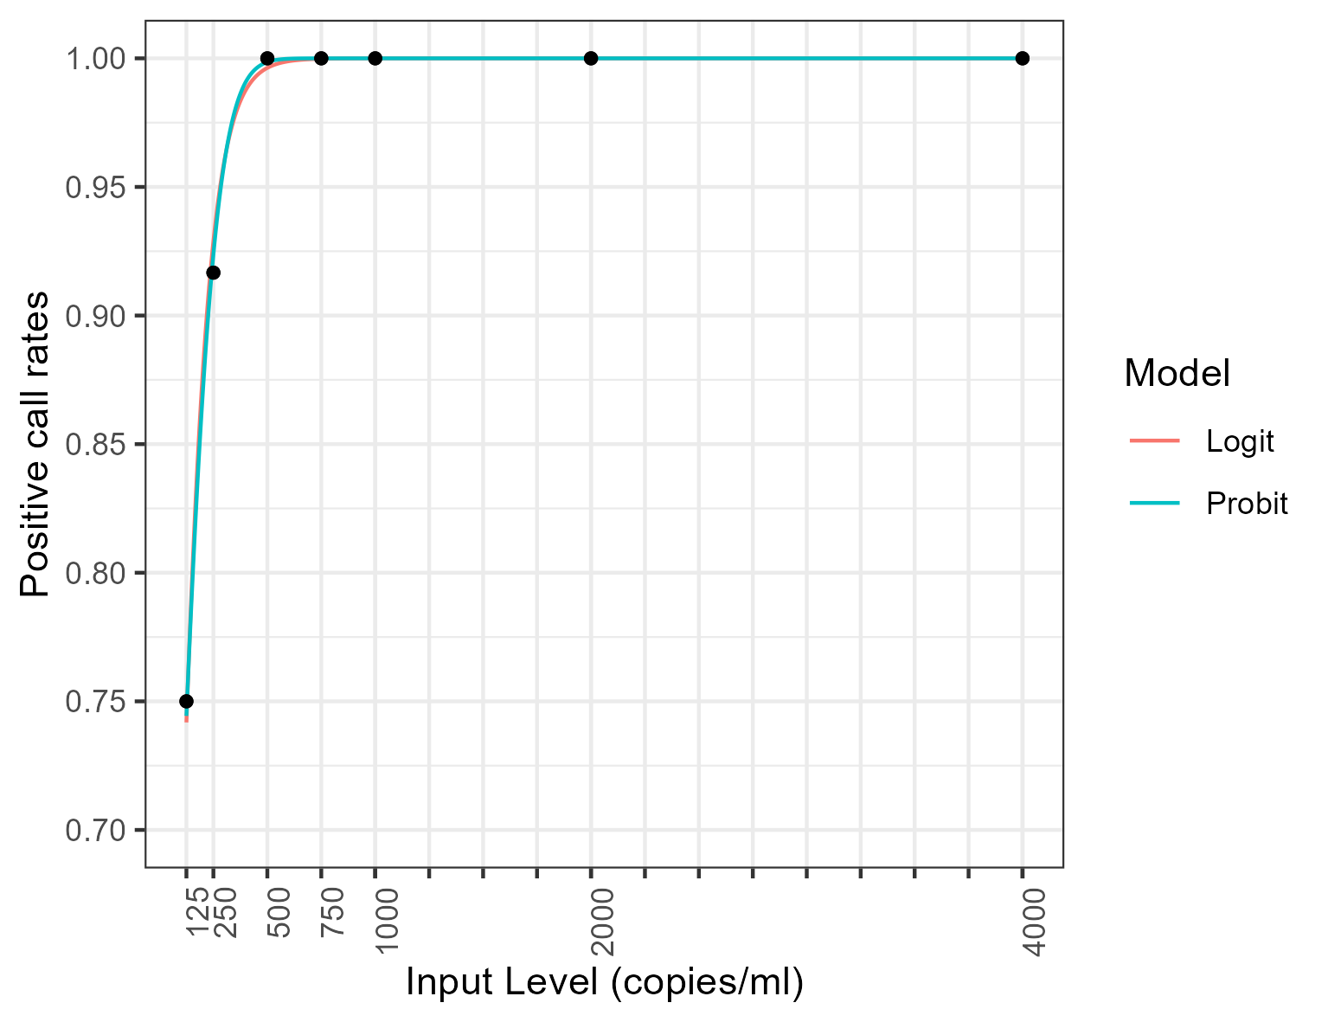
Possible consideration: Probit model

Slide 10
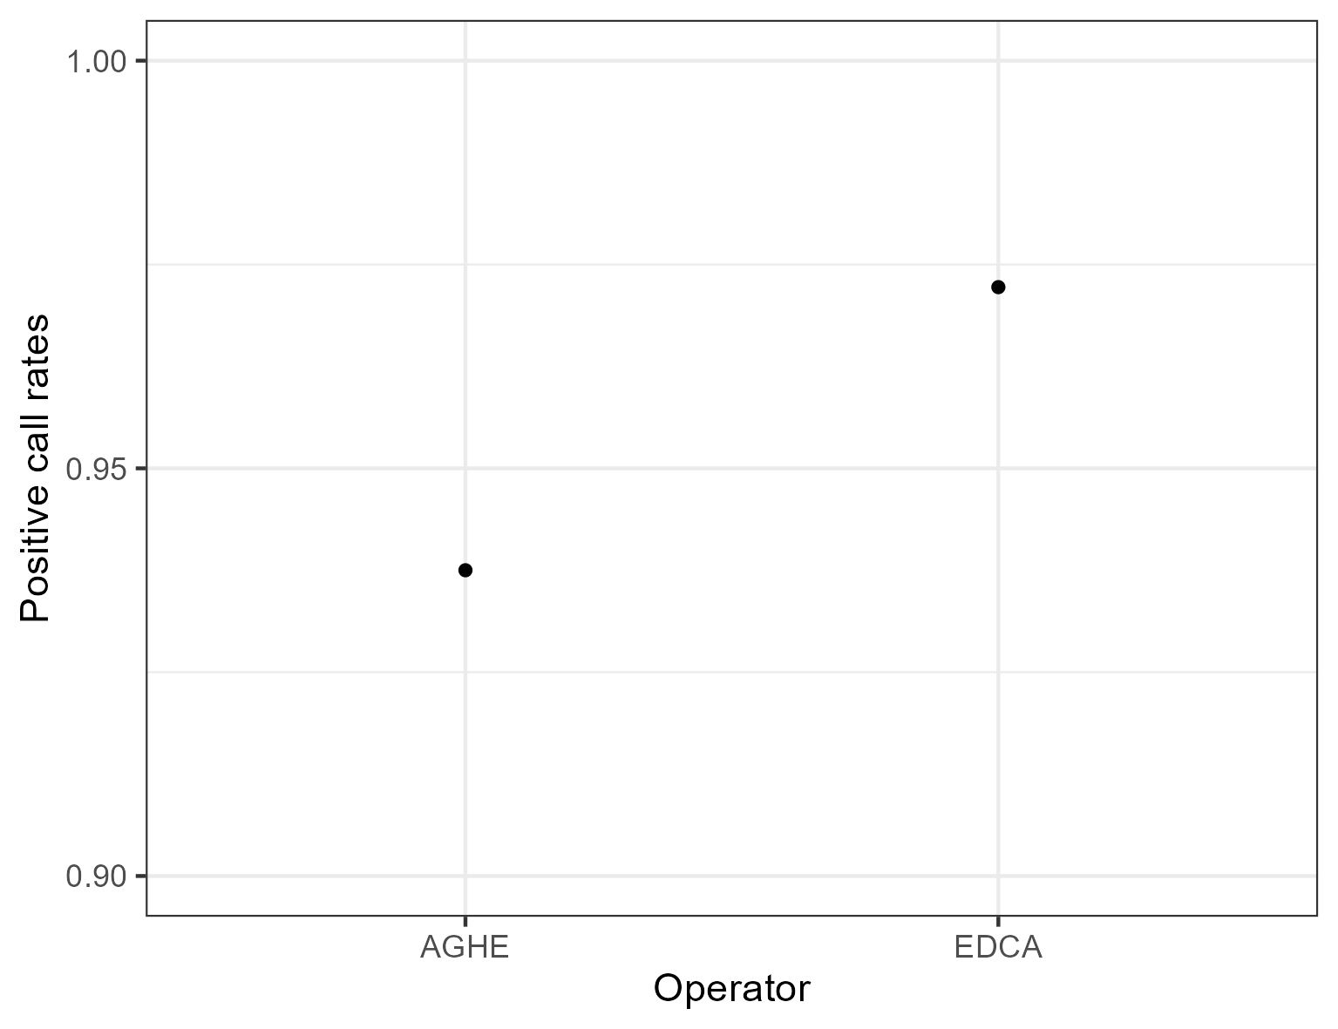
Extras

Slide 11
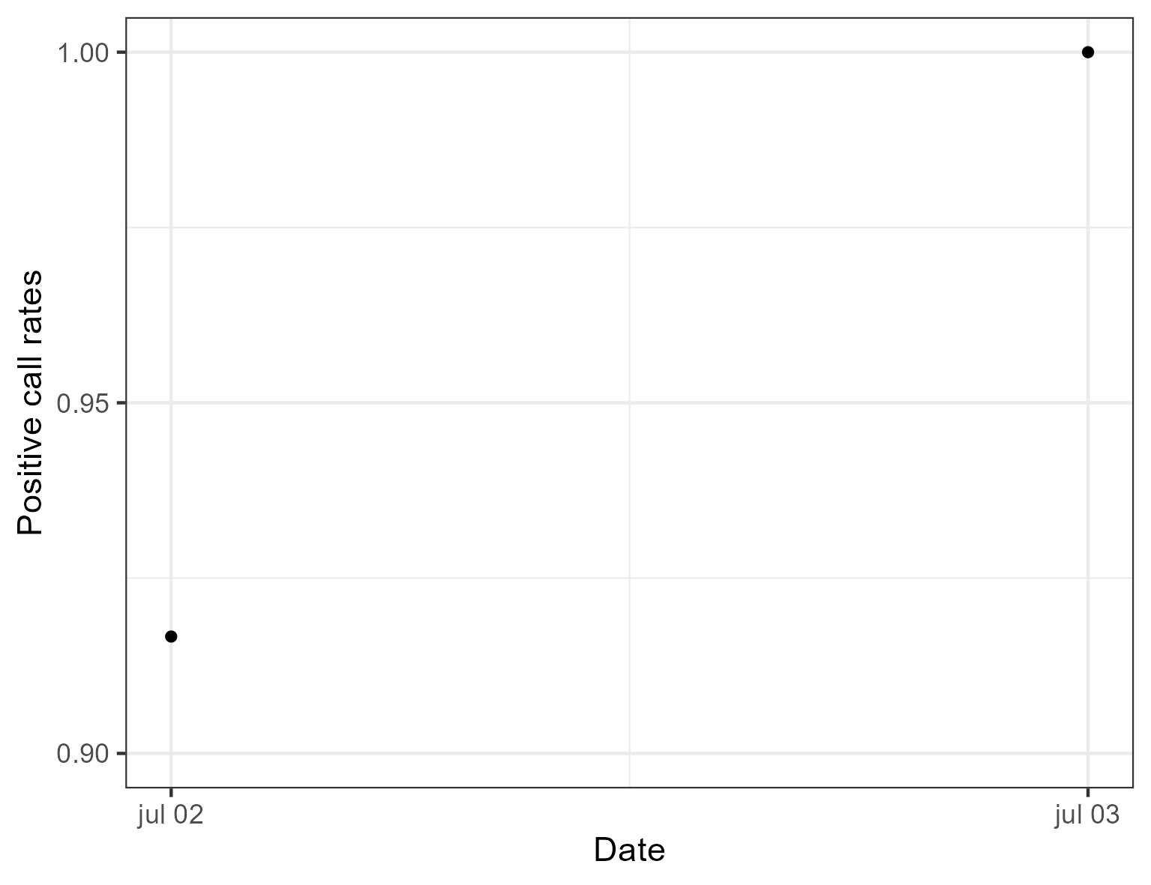

Slide 12
